Slide 1

Distributed File Systems
(DFS)
Updated by Rajkumar Buyya
* Introduction
* File service architecture
* Sun Network File System (NFS)
*→ Andrew File System (personal study)
* Recent advances
* Summary
Most concepts are
drawn from Chapter 12

Slide 2
Learning objectives
Understand the requirements that affect the design of distributed services
NFS: understand how a relatively simple, widely-used service is designed
  Obtain a knowledge of file systems, both local and networked
  Caching as an essential design technique
  Remote interfaces are not the same as APIs
  Security requires special consideration
Recent advances: appreciate the ongoing research that often leads to major advances (creation of a widely used storage infrastructures like DropBox).

Slide 3
Introduction
Why do we need a DFS?
  Primary purpose of a Distributed System…
  Resources…
    … can be inherently distributed
    … can actually be data (files, databases, …) and…
    … their availability becomes a crucial issue for the performance of a Distributed System and applications.
Connecting Users and Resources

Slide 4

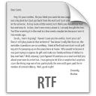










Introduction
A case for DFS
Uhm… perhaps time has come to buy a rack of servers….
Server A
I need to store my analysis and reports safely…
I want to store my thesis on the server!
I need to have my book always available..
I need storage for my reports
My boss wants…

Slide 5

Introduction
A Case for DFS
Server A
Same here… I don’t remember..
Server B
Server C
Hey… but where did I put my docs?
Uhm… … maybe we need a DFS?... Well after the paper and a nap…
Wow… now I can store a lot more documents…
I am not sure whether server A, or B, or C…

Slide 6






Introduction
A Case for DFS
Server B
Server A
Server C
Distributed File System
It is reliable, fault tolerant, highly available, location transparent…. I hope I can finish my newspaper now…
Nice… my boss will promote me!
Good… I can access my folders from anywhere..
Wow! I do not have to remember which server I stored the data into…

Slide 7


Storage systems and their properties
In first generation of distributed systems (1974-95), file systems (e.g. NFS) were the only networked storage systems.
With the advent of distributed object systems (CORBA, Java) and the web, the picture has become more complex.
Current focus is on large scale storage:
  Google File System (GFS)
  Amazon S3 (Simple Storage Service)
  Cloud Storage (e.g., DropBox,
  Google Drive, Microsoft OneDrive,
  Apple iCloud)
1974 - 1995
1995 - 2010
2010 - now
Notes:
The table of storage systems and their properties will appear on next slide.

Slide 8
Storage systems and their properties
Sharing
Persis-
Distributed
Consistency
Example
tence
cache/replicas
maintenance
Main memory
1
RAM
File system
1
UNIX file system
Distributed file system
Sun NFS
Web
Web server
Distributed shared memory
Ivy (Ch. 16)
Remote objects (RMI/ORB)
1
CORBA
Persistent object store
1
CORBA Persistent
Object Service
Peer-to-peer storage store
2
OcceanStore
Types of consistency between copies: 1 - strict one-copy consistency
  √ - approximate/slightly weaker guarantees
  X - no automatic consistency
  2 – considerably weaker guarantees
Notes:
Popup: The items appear in pairs.

Slide 9

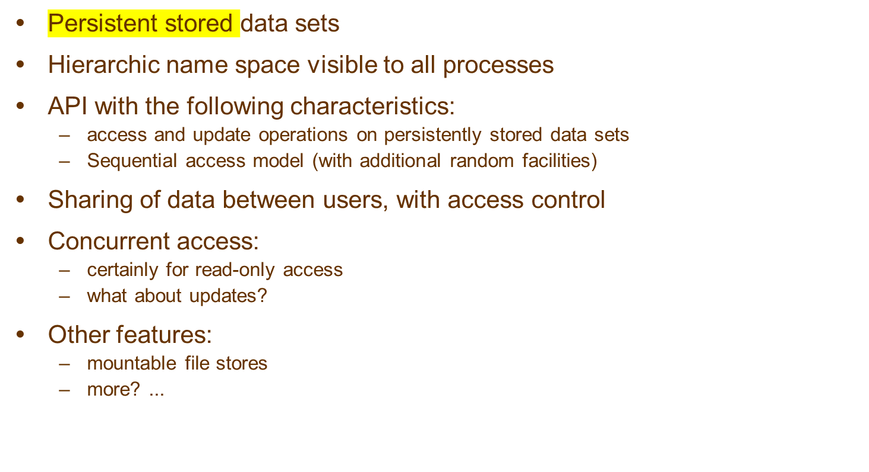
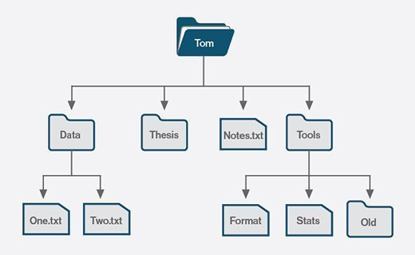

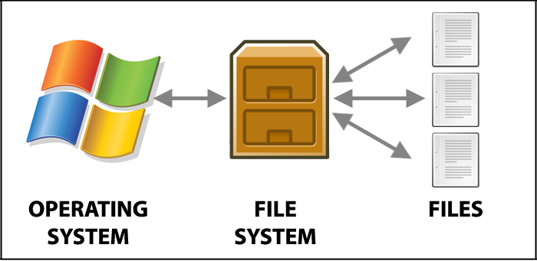

What is a file system? 1
USERS

Slide 10
What is a file system? 2
UNIX file system operations
filedes = open(name, mode)
Opens an existing file with the given name.
filedes = creat(name, mode)
Creates a new file with the given name.
Both operations deliver a file descriptor referencing the open
file. The mode is read, write or both.
status = close(filedes)
Closes the open file filedes.
count = read(filedes, buffer, n)
Transfers n bytes from the file referenced by filedes to buffer.
count = write(filedes, buffer, n)
Transfers n bytes to the file referenced by filedes from buffer.
Both operations deliver the number of bytes actually transferred
and advance the read-write pointer.
pos = lseek(filedes, offset,
Moves the read-write pointer to offset (relative or absolute,
whence)
depending on whence).
status = unlink(name)
Removes the file name from the directory structure. If the file
has no other names, it is deleted.
status = link(name1, name2)
Adds a new name (name2) for a file (name1).
status = stat(name, buffer)
Gets the file attributes for file name into buffer.

Slide 11
What is a file system? 2
Class Exercise A
Write a simple C program to copy a file using the UNIX file system operations:
copyfile(char * oldfile, * newfile)
{
  <you write this part, using open(), creat(), read(), write()>
}
Note: remember that read() returns 0 when you attempt to read beyond the end of the file.

Slide 12
A code in C – Copy File program
Write a simple C program to copy a file using the UNIX file system operations.
#define BUFSIZE 1024
#define READ 0
#define FILEMODE 0644
void copyfile(char* oldfile, char* newfile)
{ char buf[BUFSIZE]; int i,n=1, fdold, fdnew;
if((fdold = open(oldfile, READ))>=0) {
fdnew = creat(newfile, FILEMODE);
while (n>0) {
n = read(fdold, buf, BUFSIZE);
if(write(fdnew, buf, n) < 0) break;
}
close(fdold); close(fdnew);
}
else printf("Copyfile: couldn't open file: %s \n", oldfile);
}
main(int argc, char **argv) {
copyfile(argv[1], argv[2]);
}

Slide 13
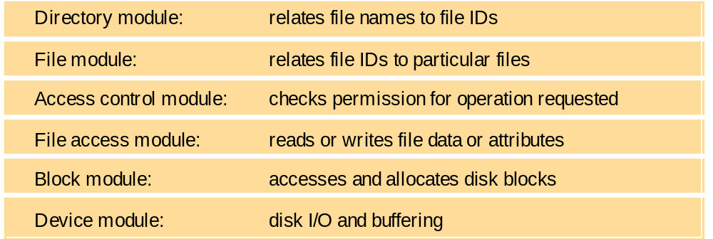


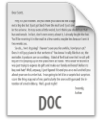

What is a file system?
(a typical module structure for implementation of non-DFS)
File system modules
Blocks
Device
Files
Directories

Slide 14
What is a file system? 4
File attribute record structure
File length
Creation timestamp
updated
by system:
Read timestamp
Write timestamp
Attribute timestamp
Reference count
Owner
updated
by owner:
File type
Access control list
E.g. for UNIX: rw-rw-r--

Slide 15
Distributed File system/service requirements
Transparency
Concurrency
Replication
Heterogeneity
Fault tolerance
Consistency
Security
Efficiency..
Tranparencies
Access: Same operations (client programs are unaware of distribution of files)
Location: Same name space after relocation of files or processes (client programs should see a uniform file name space)
Mobility: Automatic relocation of files is possible (neither client programs nor system admin tables in client nodes need to be changed when files are moved).
Performance: Satisfactory performance across a specified range of system loads
Scaling: Service can be expanded to meet additional loads or growth.
Changes to a file by one client should not interfere with the operation of other clients simultaneously accessing or changing the same file.
Concurrency properties
Isolation
File-level or record-level locking
Other forms of concurrency control to minimise contention
Replication properties
File service maintains multiple identical copies of files
Load-sharing between servers makes service more scalable
Local access has better response (lower latency)
Fault tolerance
Full replication is difficult to implement.
Caching (of all or part of a file) gives most of the benefits (except fault tolerance)
Heterogeneity properties
Service can be accessed by clients running on (almost) any OS or hardware platform.
Design must be compatible with the file systems of different OSes
Service interfaces must be open - precise specifications of APIs are published.
Fault tolerance
Service must continue to operate even when clients make errors or crash.
Service must resume after a server machine crashes.
If the service is replicated, it can continue to operate even during a server crash.
Consistency
Unix offers one-copy update semantics for operations on local files - caching is completely transparent.
Difficult to achieve the same for distributed file systems while maintaining good performance and scalability.
Security
Must maintain access control and privacy as for local files.
  based on identity of user making request
  identities of remote users must be authenticated
  privacy requires secure communication
Service interfaces are open to all processes not excluded by a firewall.
  vulnerable to impersonation and other attacks
Efficiency
Goal for distributed file systems is usually performance comparable to local file system.
File service is most heavily loaded
service in an intranet, so its
functionality and performance
are critical
*
Notes:
Popup: There are overlays discussing each requirement

Slide 16
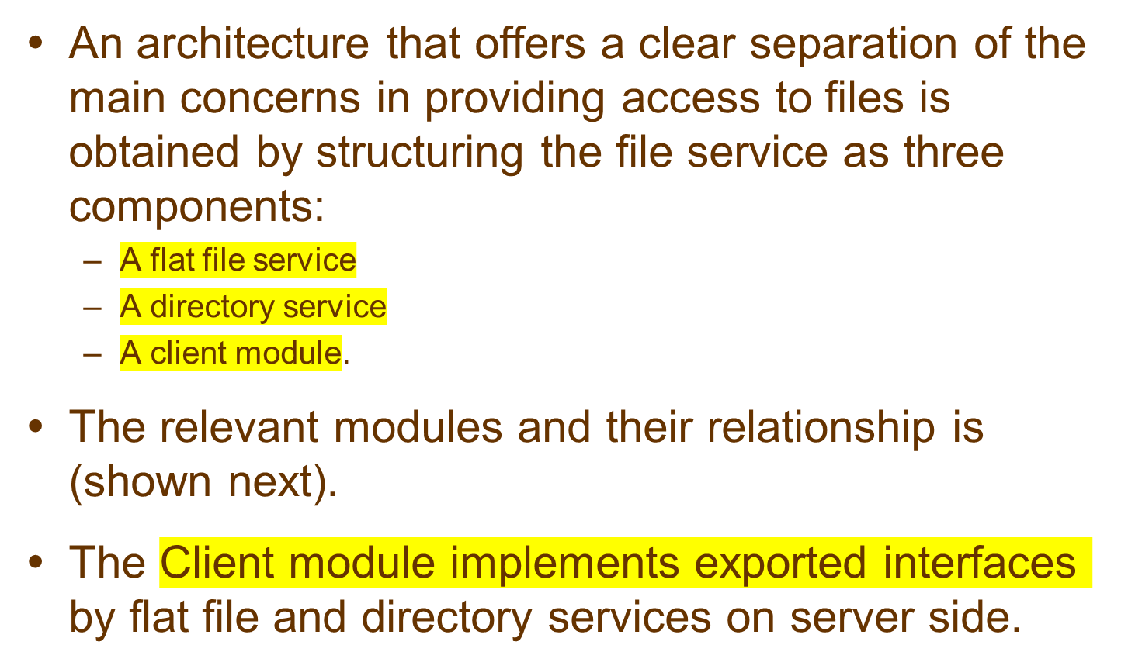
File Service Architecture

Slide 17
Model file service architecture
Lookup
AddName
UnName
GetNames
Client computer
Server computer
Application
Application
Directory service
program
program
Flat file service
Client module
Read
Write
Create
Delete
GetAttributes
SetAttributes
Notes:
Popup shows names of the file and directory operations.
If the Unix file primitives are mapped directly onto file server operations, it is impossible to support many of the requirements outlined on the previous slide.
Instead, the file service is implemented in part by a module that runs in the client computer. The Client module implements nearly all of the state-dependent functionality (open files, position of read-write pointer, etc.)- supporting fault tolerance - and it maintains a cache of recently-used file data - efficiency, limited replication and scalability. It also translates the file operations performed by applications into the API of the file server - transparency and heterogeneity. It supplies authentication information and performs encryption when necessary, but access control checks must be made by the server.

Slide 18
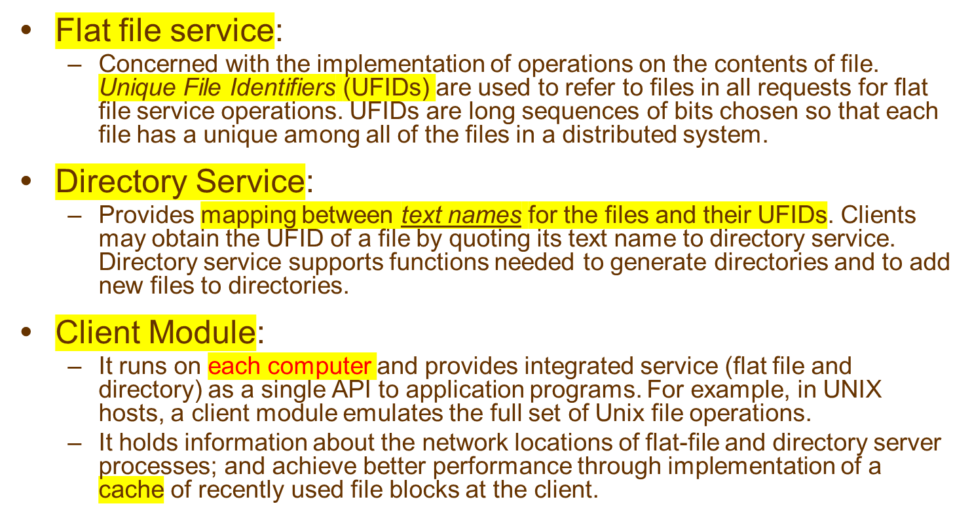
Responsibilities of various modules

Slide 19
Server operations/interfaces for the model file service
Flat file service
Read(FileId, i, n) -> Data
Write(FileId, i, Data)
Create() -> FileId
Delete(FileId)
GetAttributes(FileId) -> Attr
SetAttributes(FileId, Attr)
Directory service
Lookup(Dir, Name) -> FileId
AddName(Dir, Name, File)
UnName(Dir, Name)
GetNames(Dir, Pattern) -> NameSeq
position of first byte
FileId
position of first byte
Pathname lookup
Pathnames such as '/usr/bin/tar' are resolved by iterative calls to lookup(), one call for each component of the path, starting with the ID of the root directory '/' which is known in every client.
FileId
A unique identifier for files anywhere in the network. Similar to the remote object references described in Section 4.3.3.
Notes:
Note that open files and RW pointer are eliminated from this interface.
All Flat File service (and Directory Service) operations are repeatable - idempotent - except Create. Neither of the server modules maintains any state on behalf of the client (unless encryption is used).

Slide 20
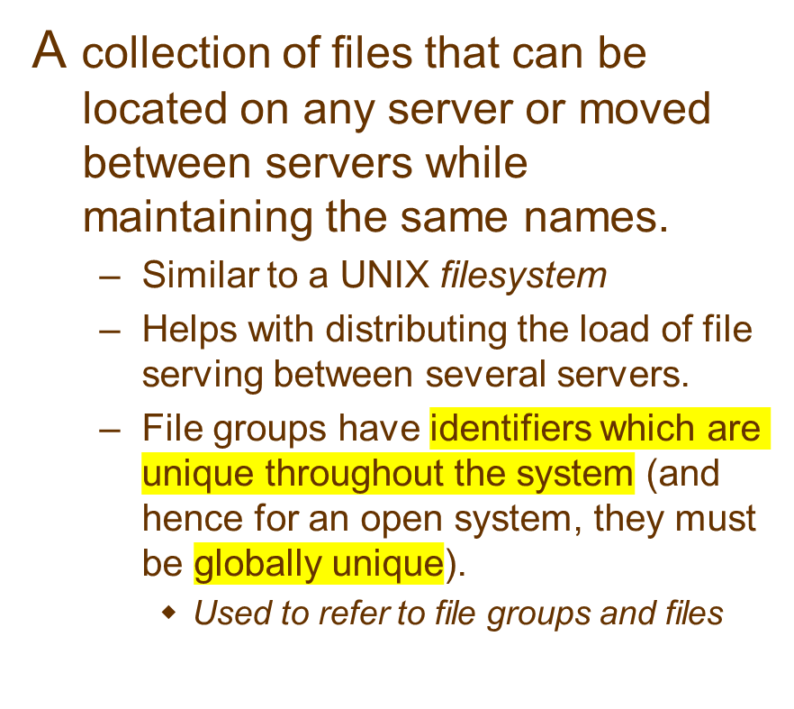
File Group
To construct a globally unique ID we use some unique attribute of the machine on which it is created, e.g. IP number, even though the file group may move subsequently.
File Group ID:
32 bits
16 bits
IP address
date
Notes:
Pop-up about construction of globally unique ID.

Slide 21
DFS: Case Studies
NFS (Network File System)
  Developed by Sun Microsystems (in 1985)
  Most popular, open, and widely used.
  NFS protocol standardised through IETF (RFC 1813)
AFS (Andrew File System)
  Developed by Carnegie Mellon University as part of Andrew distributed computing environments (in 1986)
  A research project to create campus wide file system.
  Public domain implementation is available on Linux (LinuxAFS)
  It was adopted as a basis for the DCE/DFS file system in the Open Software Foundation (OSF, www.opengroup.org) DEC (Distributed Computing Environment)

Slide 22
Case Study: Sun NFS
An industry standard for file sharing on local networks since the 1980s
An open standard with clear and simple interfaces
Closely follows the abstract file service model defined above
Supports many of the design requirements already mentioned:
  transparency
  heterogeneity
  efficiency
  fault tolerance
Limited achievement of:
  concurrency
  replication
  consistency
  security

Slide 23
NFS - History
1985: Original Version (in-house use)
1989: NFSv2 (RFC 1094)
  Operated entirely over UDP
  Stateless protocol (the core)
  Support for 2GB files
1995: NFSv3 (RFC 1813)
  Support for 64 bit (> 2GB files)
  Support for asynchronous writes
  Support for TCP
  Support for additional attributes
  Other improvements
2000-2003: NFSv4 (RFC 3010, RFC 3530)
  Collaboration with IETF
  Sun hands over the development of NFS
2010: NFSv4.1
  Adds Parallel NFS (pNFS) for parallel data access
2015
  RFC 7530 – NFS Version 4 Protocol
  Unlike earlier versions, it supports traditional file access while integrating support for file locking and the MOUNT protocol. It makes NFS operate well in an Internet environment.

Slide 24
NFS architecture
Client computer
Client computer
Application
NFS
Client
Server computer
program
Application
Application
Application
program
program
Kernel
program
UNIX
system calls
UNIX kernel
Virtual file system
Virtual file system
Operations
on local files
Operations
on
remote files
UNIX
Other
file system
NFS
Client
UNIX
file
NFS
NFS
file
system
client
server
system
NFS
protocol
(remote operations)
Notes:
Popup 1 adds more labels

Slide 25
NFS architecture: does the implementation have to be in the system kernel?
No:
  there are examples of NFS clients and servers that run at application-level as libraries or processes (e.g. early Windows and MacOS implementations, current PocketPC, etc.)
But, for a Unix implementation there are advantages:
  Binary code compatible - no need to recompile applications
    Standard system calls that access remote files can be routed through the NFS client module by the kernel
  Shared cache of recently-used blocks at client
  Kernel-level server can access i-nodes and file blocks directly
    but a privileged (root) application program could do almost the same.
  Security of the encryption key used for authentication.
Notes:
Although the NFS client and server modules reside in the kernel in standard Unix implementations, it is perfectly possible to construct application-level versions.
Examples of application-level clients or servers: Windows 3.0, Win 95?, early MacOS, PocketPC

Slide 26
NFS server operations (simplified)
read(fh, offset, count) -> attr, data
write(fh, offset, count, data) -> attr
create(dirfh, name, attr) -> newfh, attr
remove(dirfh, name) status
getattr(fh) -> attr
setattr(fh, attr) -> attr
lookup(dirfh, name) -> fh, attr
rename(dirfh, name, todirfh, toname)
link(newdirfh, newname, dirfh, name)
readdir(dirfh, cookie, count) -> entries
symlink(newdirfh, newname, string) -> status
readlink(fh) -> string
mkdir(dirfh, name, attr) -> newfh, attr
rmdir(dirfh, name) -> status
statfs(fh) -> fsstats
fh = file handle:
Model flat file service
Read(FileId, i, n) -> Data
Write(FileId, i, Data)
Create() -> FileId
Delete(FileId)
GetAttributes(FileId) -> Attr
SetAttributes(FileId, Attr)
Filesystem identifier
i-node number
i-node generation
Model directory service
Lookup(Dir, Name) -> FileId
AddName(Dir, Name, File)
UnName(Dir, Name)
GetNames(Dir, Pattern)
->NameSeq
Notes:
Idempotent read/write
getattr is used to implement fstat(), setattr is used to update the attributes
NFS Create adds file to directory, whereas we use two operations in MFS
Popup shows Model directory service ops
Optional:
Class Exercise C
Show how each file operation of the program that you wrote in Class Exercise A would be executed using the operations of the NFS server operations

Slide 27
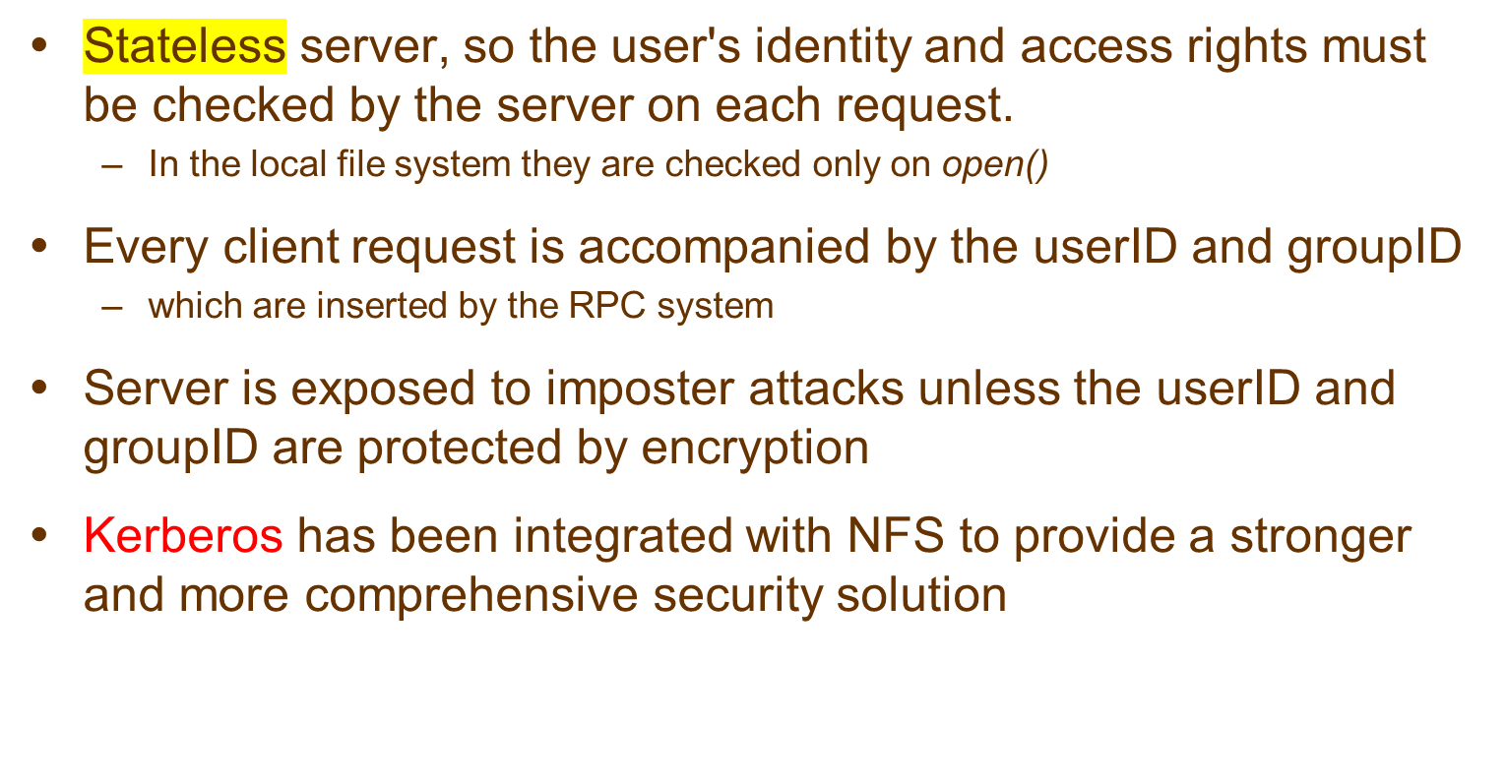
NFS access control and authentication
Notes:
Kerberized NFS is described below.

Slide 28
Architecture Components (UNIX / Linux)
Server:
  nfsd: NFS server daemon that services requests from clients.
  mountd: NFS mount daemon that carries out the mount request passed on by nfsd.
  rpcbind: RPC port mapper used to locate the nfsd daemon.
  /etc/exports: configuration file that defines which portion of the file systems are exported through NFS and how.
Client:
  mount: standard file system mount command.
  /etc/fstab: file system table file.
  nfsiod: (optional) local asynchronous NFS I/O server.

Slide 29
Mount service
Mount operation:
mount(remotehost, remotedirectory, localdirectory)
Server maintains a table of clients who have mounted filesystems at that server
Each client maintains a table of mounted file systems holding:
< IP address, port number, file handle>
Hard versus soft mounts

Slide 30
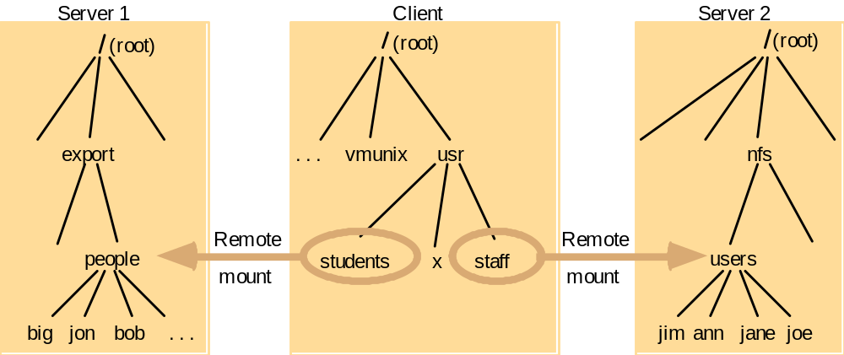
Local and remote file systems accessible on an NFS client
Note: The file system mounted at /usr/students in the client is actually the sub-tree located at /export/people in Server 1;
the file system mounted at /usr/staff in the client is actually the sub-tree located at /nfs/users in Server 2.

Slide 31
Automounter
NFS client catches attempts to access 'empty' mount points and routes them to the Automounter
  Automounter has a table of mount points and multiple candidate serves for each
  it sends a probe message to each candidate server and then uses the mount service to mount the filesystem at the first server to respond
Keeps the mount table small
Provides a simple form of replication for read-only filesystems
  E.g. if there are several servers with identical copies of /usr/lib then each server will have a chance of being mounted at some clients.
Notes:
Hidden

Slide 32
Kerberized NFS
Kerberos protocol is too costly to apply on each file access request
Kerberos is used in the mount service:
  to authenticate the user's identity
  User's UserID and GroupID are stored at the server with the client's IP address
For each file request:
  The UserID and GroupID sent must match those stored at the server
  IP addresses must also match
This approach has some problems
  can't accommodate multiple users sharing the same client computer
  all remote filestores must be mounted each time a user logs in

Slide 33
New design approaches
Distribute file data across several servers
  Exploits high-speed networks (InfiniBand, Gigabit Ethernet)
  Layered approach, lowest level is like a 'distributed virtual disk'
  Achieves scalability even for a single heavily-used file
'Serverless' architecture
  Exploits processing and disk resources in all available network nodes
  Service is distributed at the level of individual files
Examples:
  xFS : Experimental implementation demonstrated a substantial performance gain over NFS and AFS
  Peer-to-peer systems: Napster, OceanStore (UCB), Farsite (MSR), Publius (AT&T research) - see web for documentation on these very recent systems
  Cloud-based File Systems: DropBox

Slide 34













DropBox Cloud Storage Architecture
Dropbox Folder
Automatic
synchronization
Dropbox Folder
Dropbox Folder

Slide 35
Summary
Distributed File systems provide illusion of a local file system and hide complexity from end users.
NFS is an excellent example of a distributed service designed to meet many important design requirements
Effective client caching can produce file service performance equal to or better than local file systems
Consistency versus update semantics versus fault tolerance remains an issue
Most client and server failures can be masked
Superior scalability can be achieved with whole-file serving (Andrew FS) or the distributed virtual disk approach
Modern DFSs are Cloud-based Files Systems (..Dropbox, GoogleDrive, OneDrive,..)
Advanced Features:
  support for mobile users, disconnected operation, automatic re-integration
  support for data streaming and quality of service (Tiger file system, Content Delivery Networks)

